Slide 1
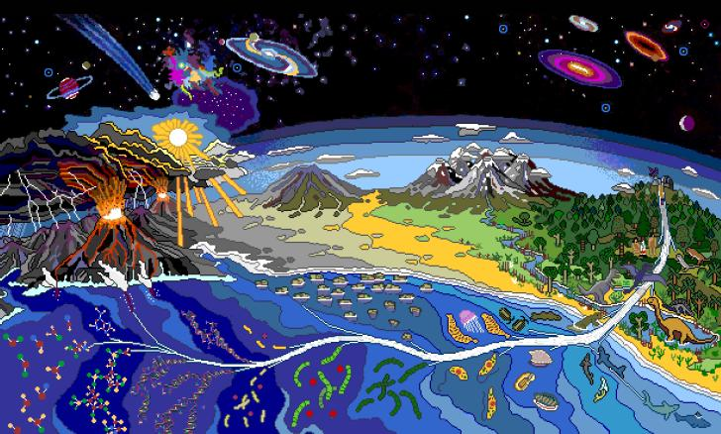
The origin of Life

Slide 2
Early hypotheses
Spontaneous generation or abiogenesis
  Living things come from non-living things
Greeks, Egyptians thought of an “active principle”
  Life forms come from non-living matter or that the air has a life force

Slide 3
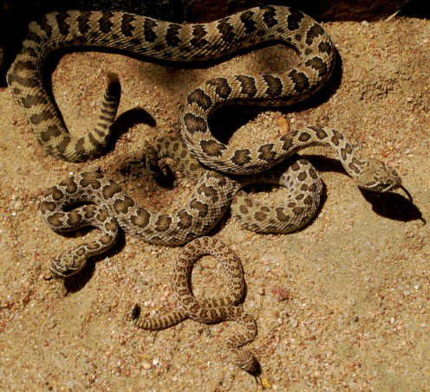

Slide 4
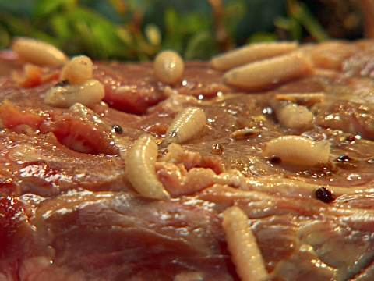

Slide 5
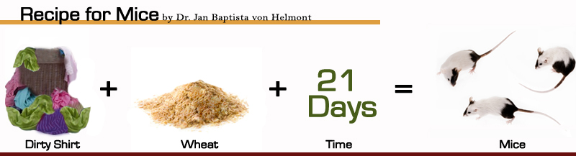
Helmont and the 1600’s

Slide 6
Redi in the mid 1600’s
Redi opposed spontaneous generation
  He looked at the maggots arising from meat of the Egyptians and Greeks, along with Helmont
  Think about it…
    How could you set up a controlled experiment to show that maggots do not arise from meat but are instead attracted to meat for laying fly larvae (maggots)
      Turn and talk with a neighbor (1 minute)
    Materials:
      3 Glass jars
      Meat
      flies

Slide 7
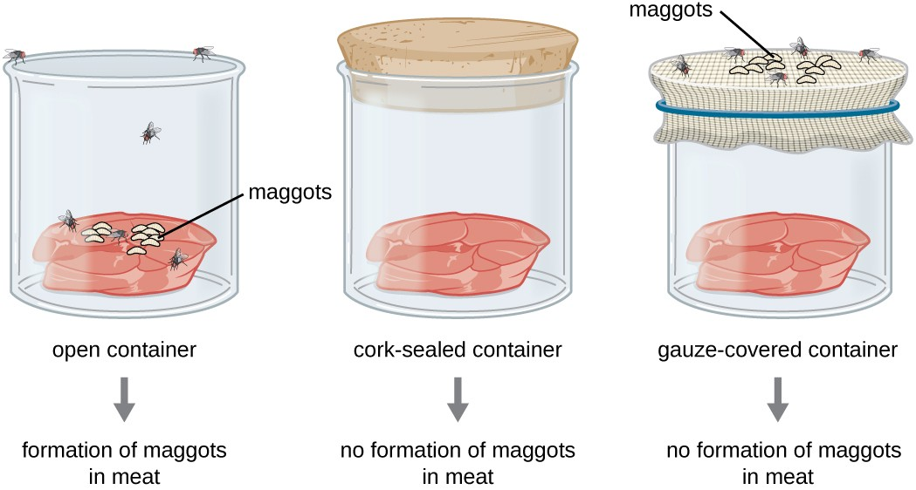
Redi experiment diagram

Slide 8
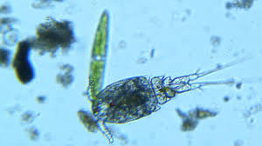
Leeuwenhoek
Inventor of the microscope
  Sees microbes in a drop of “sterile” water
  The water was in a container that had mixed with soil added into it….. The water was not sterile

Slide 9
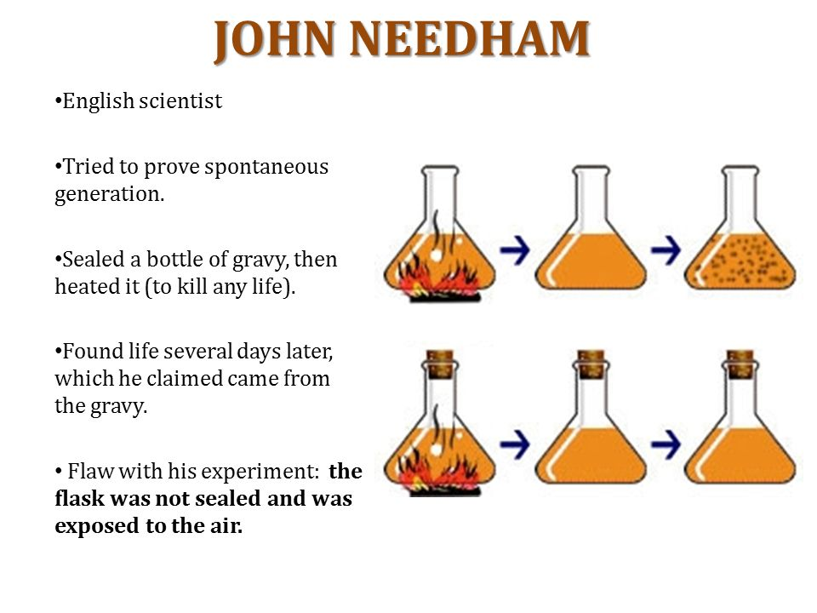
Needham

Slide 10
Spallanzani 1765
Challenged Needhams experiment
Boiled 2 flasks with broth
One with no covering One with covering
Flaw: did not heat the flask long enough and he only proved that life could not survive without air

Slide 11
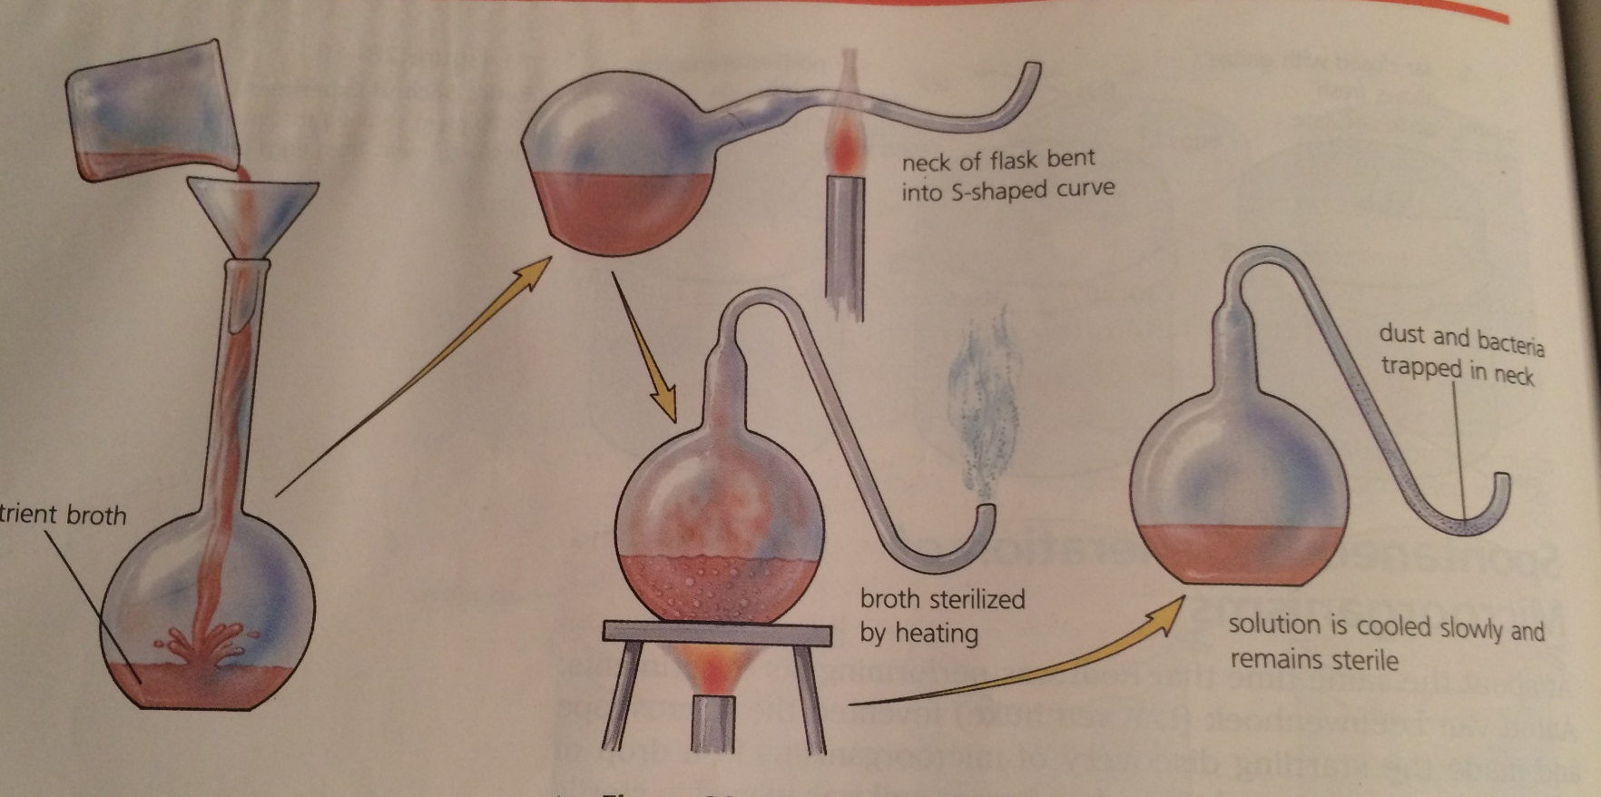
Louis pasteur in 1860!!
Disproves spontaneous generation

Slide 12
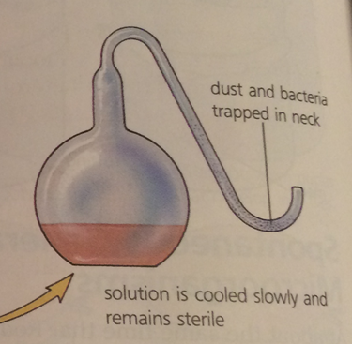
What would happen if the broth in the flask was tipped?

Slide 13
Biogenesis
Biogenesis – living things originate from other living things
BUT WAIT…. How did the first living thing develop then??
  Enter the heterotroph hypothesis

Slide 14
The heterotroph hypothesis in the 1920s
Heterotroph Hypothesis: Explains how the origin of life on earth developed

Slide 15
Lets travel back in time
How old is earth?
  4.5 billion years old
Primitive earth conditions about 4 billion years ago
Conditions….

Slide 16
Conditions
Chemicals Natural Lacked
* not present or much lower in modern earth
** present in modern earth
CH4*
NH3*
H2O
H2
X-ray*
UV radiation*
Lightning
Volcanos
HEAT*
Ozone Layer**

Slide 17
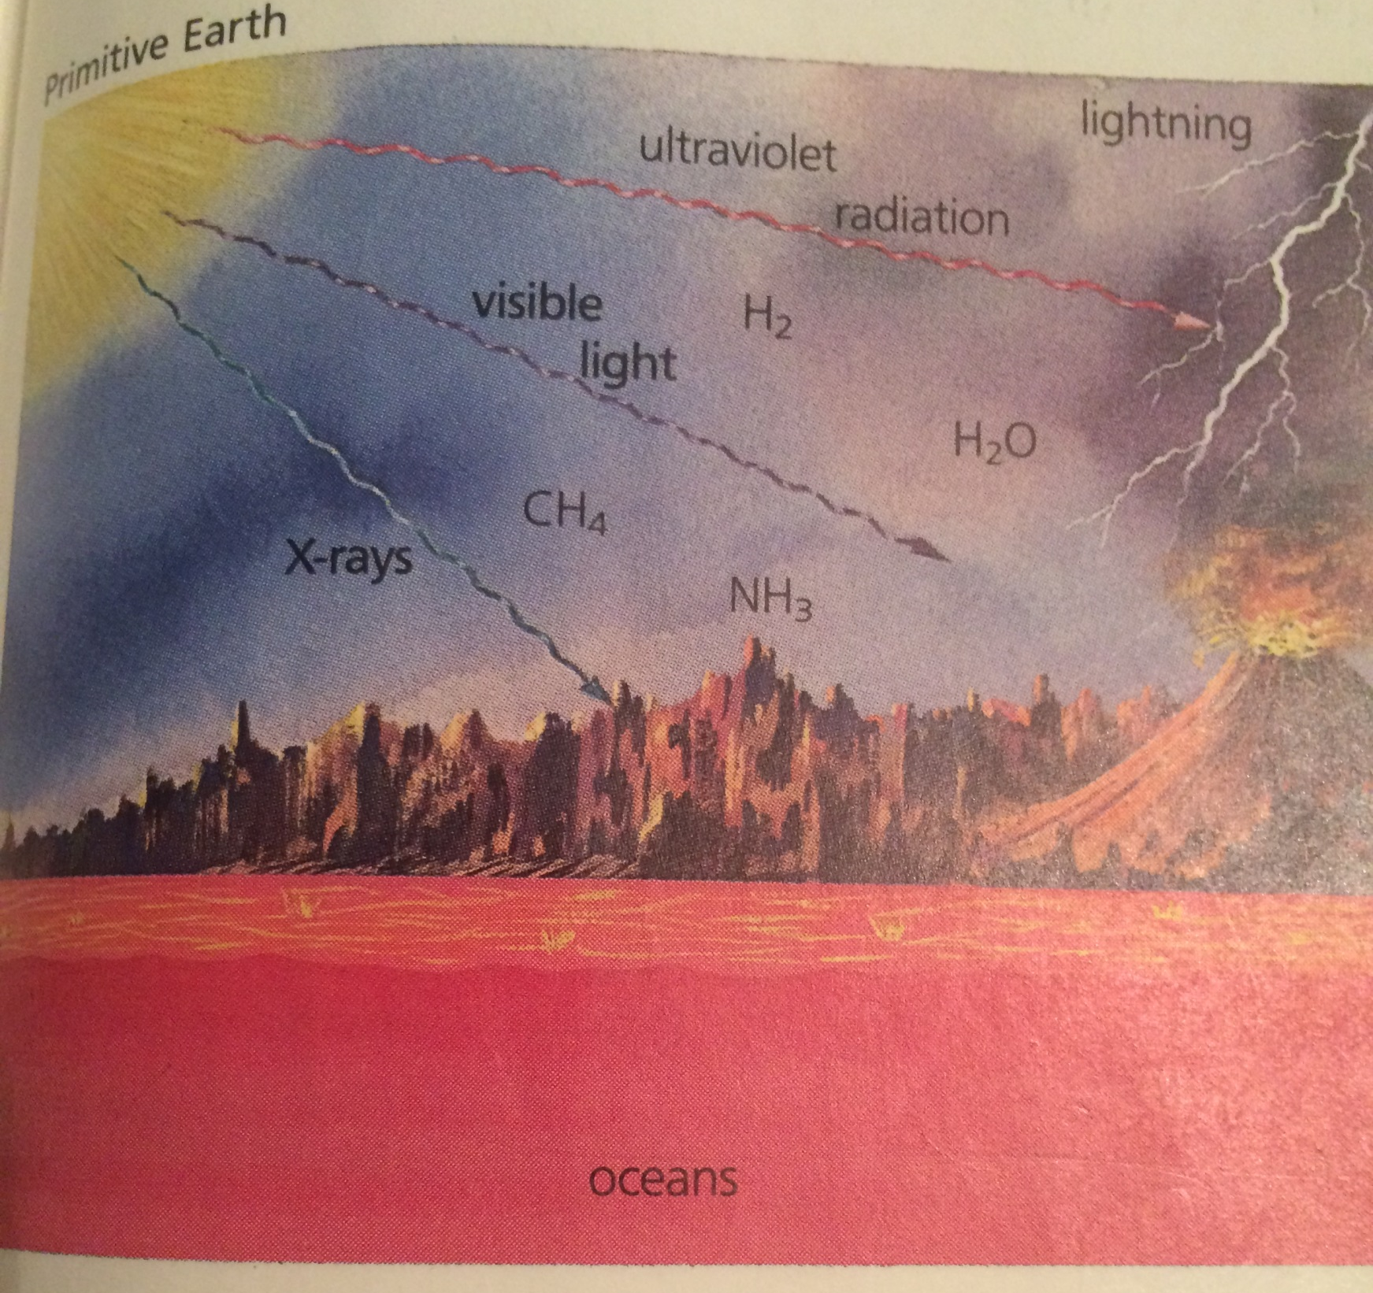
Primitive Earth

Slide 18
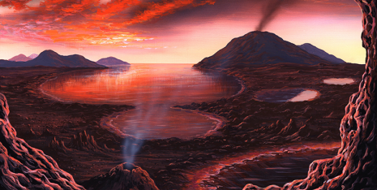

Slide 19
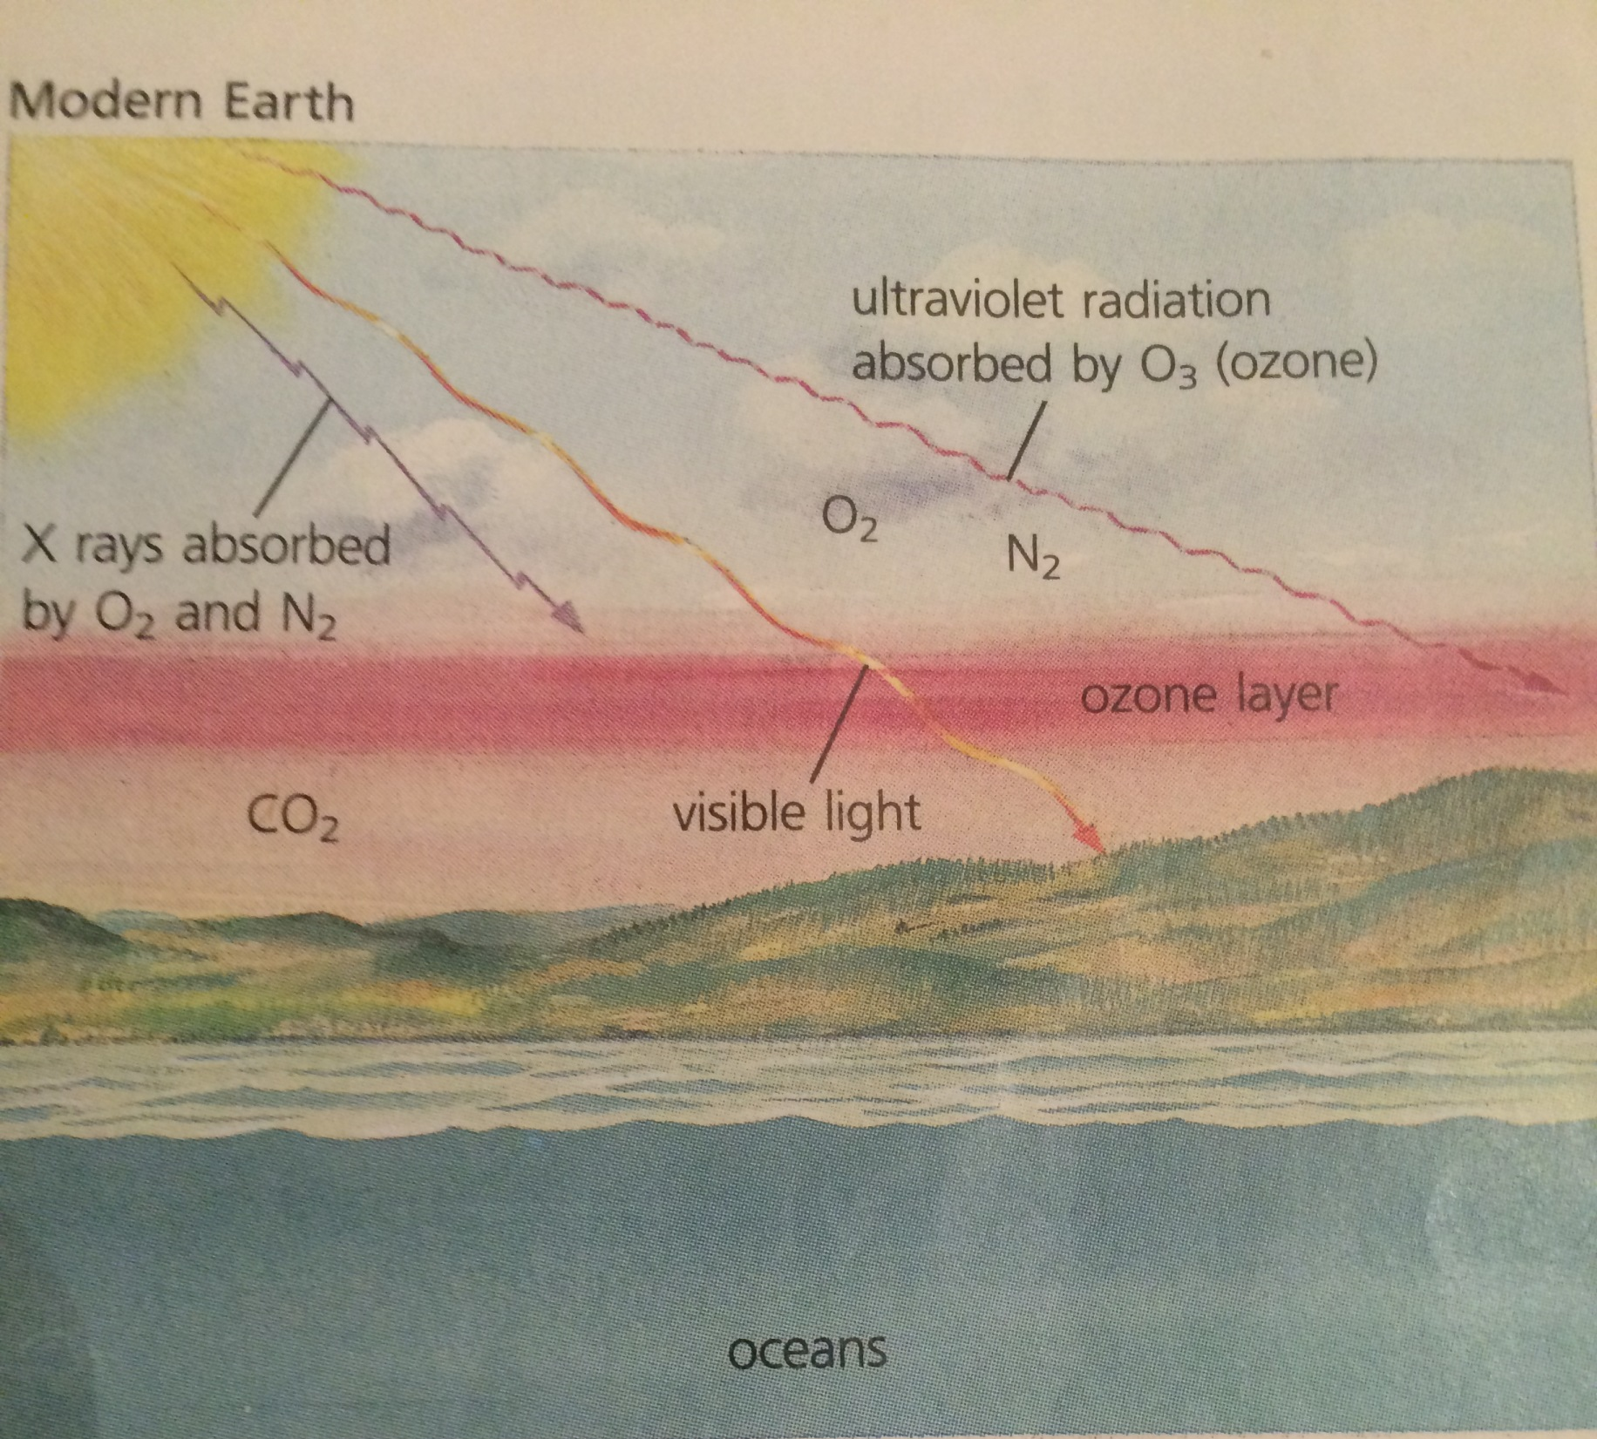

Slide 20
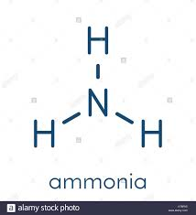
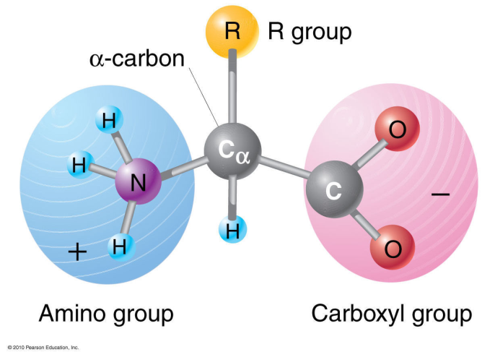
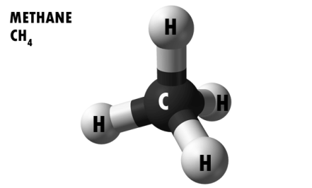
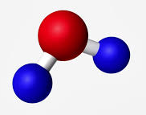
Inorganic → Organic Molecules
Overarching concept – Heat and other energy sources needed to break and form chemical bonds.
Energy sources in primal earth:
  Radioactive elements in earth crust
  Electrical energy → Lightning ****
  X-ray and ultroviolet radiation

Slide 21
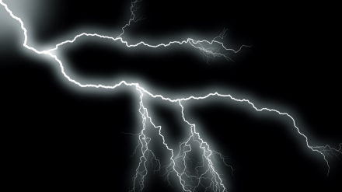
Miller’s Hypothesis
Simulates the formation of organic compounds from the gases found on primitive earth (methane CH4, Ammonia NH3, Water H2O, and Hydrogen H2)
Basis for organic molecules include combinations of CHON
Also need a source of energy → heat
  Need a spark LIGHTNING

Slide 22
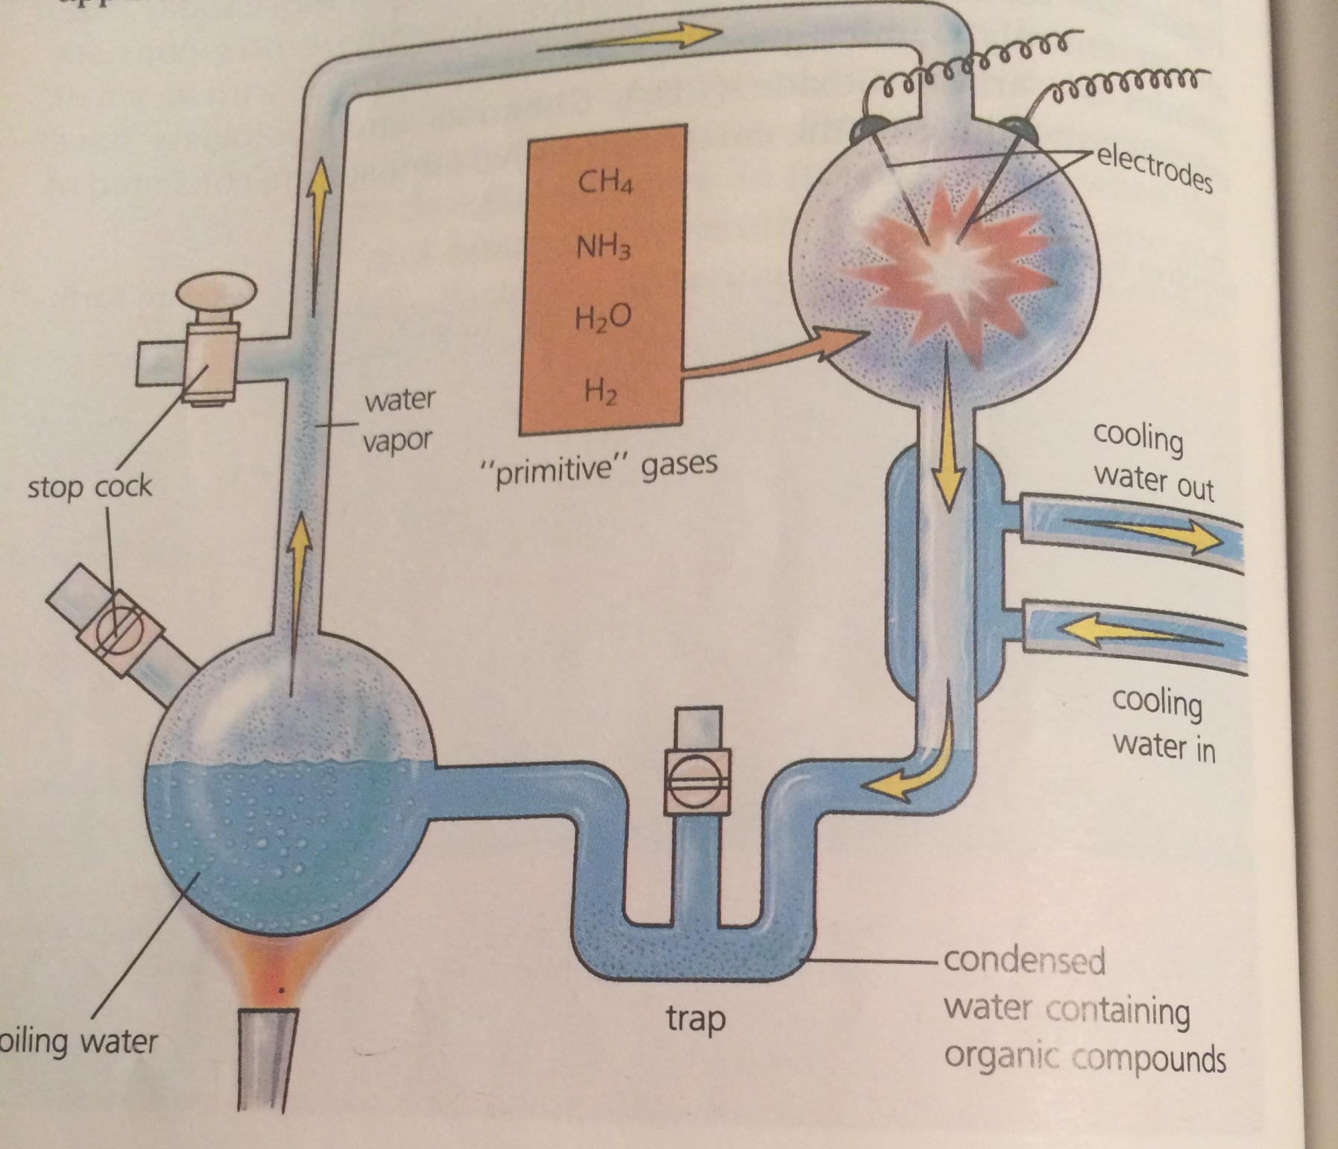

Slide 23
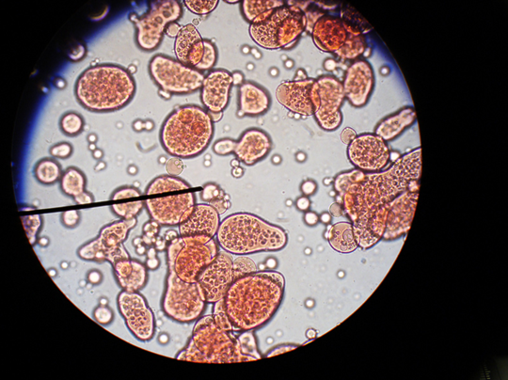
Coacervates (the first heterotrophs) Anaerobic or aerobic?
- Found in the primal soup of
oceans
- form clusters of large organic molecules
- Water molecules form a “shell” (bubble like membrane) which → internal contents can be chemically different from the external environment
Leads to build up of C02 in the atmosphere

Slide 24
Build up of co2 in the atmosphere leads to…
First autotrophs (first photosynthetic organisms)
  What molecule do photosynthetic organisms produce?
  CO2+ H2O → O2 + Sugar (C H O )

Slide 25
Oxygen or O2
Now that we have the building up of Oxygen in the air…
We now have the aerobic respiration organisms that can arise
  They use oxygen and produce C02
The autotrophs and aerobic respiration organisms leads to a balance in the amount of O2 and CO2 in the atmosphere….

Slide 26

Lightning
Development of an Atmosphere
Lighting coverts O2 ( oxygen) in the air into O3 (ozone)
Ozone → an atmosphere

Slide 27
Why does the atmosphere matter?
Organisms now have the atmospheric protection from harmful X-rays and radiation
  Our current atmosphere was being depleted → increase rates of skin cancer…. It is now bouncing back

Slide 28
Prep-Task
Complete the section Review questions for chapter 28-4 and 28-5 attached to the back of your notes Use your notes and the reading on pages 585-593.

